Slide 1

Your past. Your present. Your future.
Notes:
I would like you to try and remember your happiest memory. Now, think about yourselves 40 years from now. You may no longer remember that moment. Wouldn’t you like to capture those moments and relive them in the future? That’s what Capsulefy is about.

Slide 2
OVERVIEW
Idea
Team
Technologies
Demo
Competitors
Pilot users
Planification
Costs
Profit estimations

Slide 3
IDEA

Slide 4





IDEA: TIME CAPSULE
Write
Schedule
Wait
Publish

Slide 5


IDEA: DEADMAN SWITCH
ON

Slide 6
TEAM

Slide 7
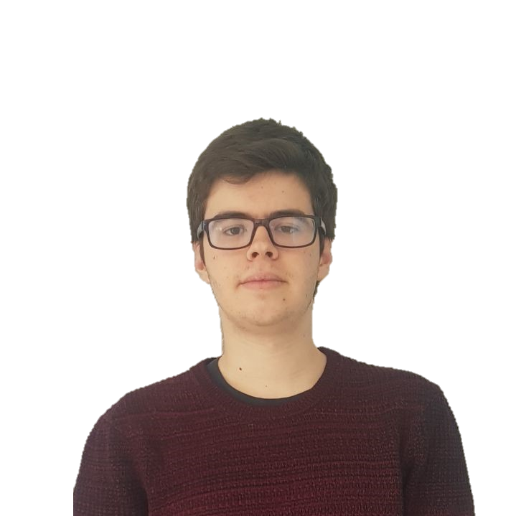



TEAM
Pablo Rebollo
Project manager, backend developer

Slide 8



TEAM
Adrián Cantón
Business manager, full-stack developer

Slide 9


TEAM
Daniel Carpio
Analist, frontend developer

Slide 10


TEAM
Juan Rodríguez
Requirements engineer, backend developer

Slide 11


TEAM
Rafael Fresno
Backend developer, API integration

Slide 12




GOALS

Slide 13


TEAM PERFORMANCE

Slide 14
TECHNOLOGIES

Slide 15




TECHNOLOGIES
Main web app
Users and capsules
Social media

Slide 16




SUPPORTING TOOLS

Slide 17



ALM
Notes:
Mention Toggl, although it is not part of the ALM itself.

Slide 18


TESTING
Functional & integration
Coverage
Performance

Slide 19
DEMO

Slide 20
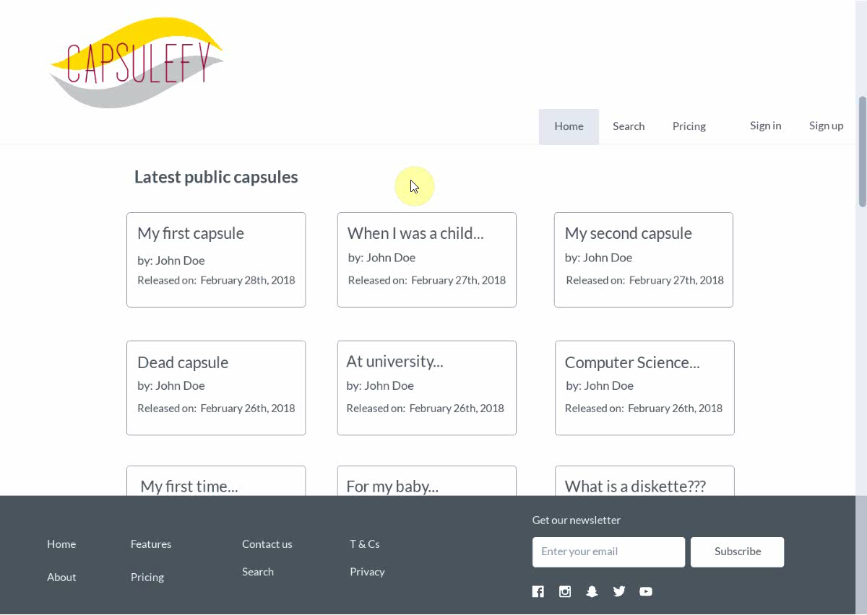
No logged user
Listing capsules

Slide 21
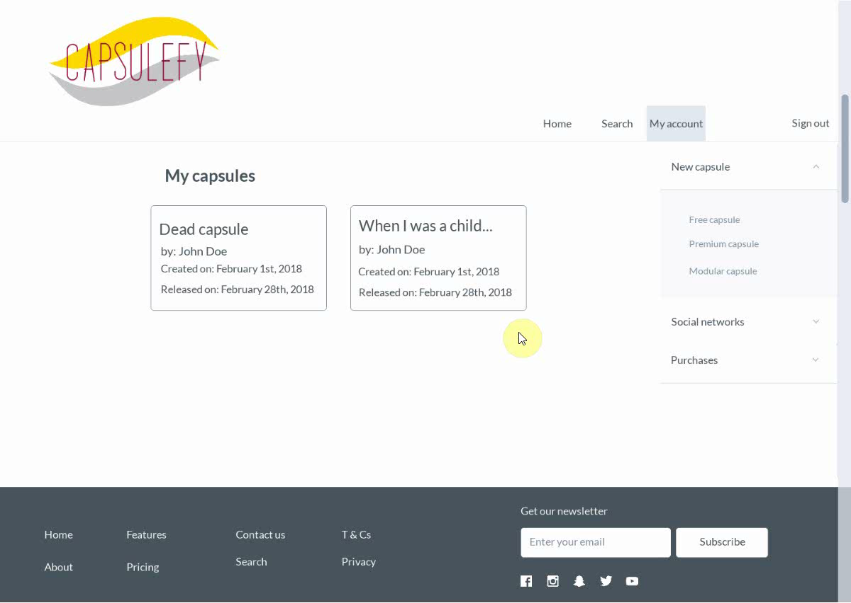
Logged-in user
Free capsules

Slide 22

Logged-in user
Premium capsules

Slide 23
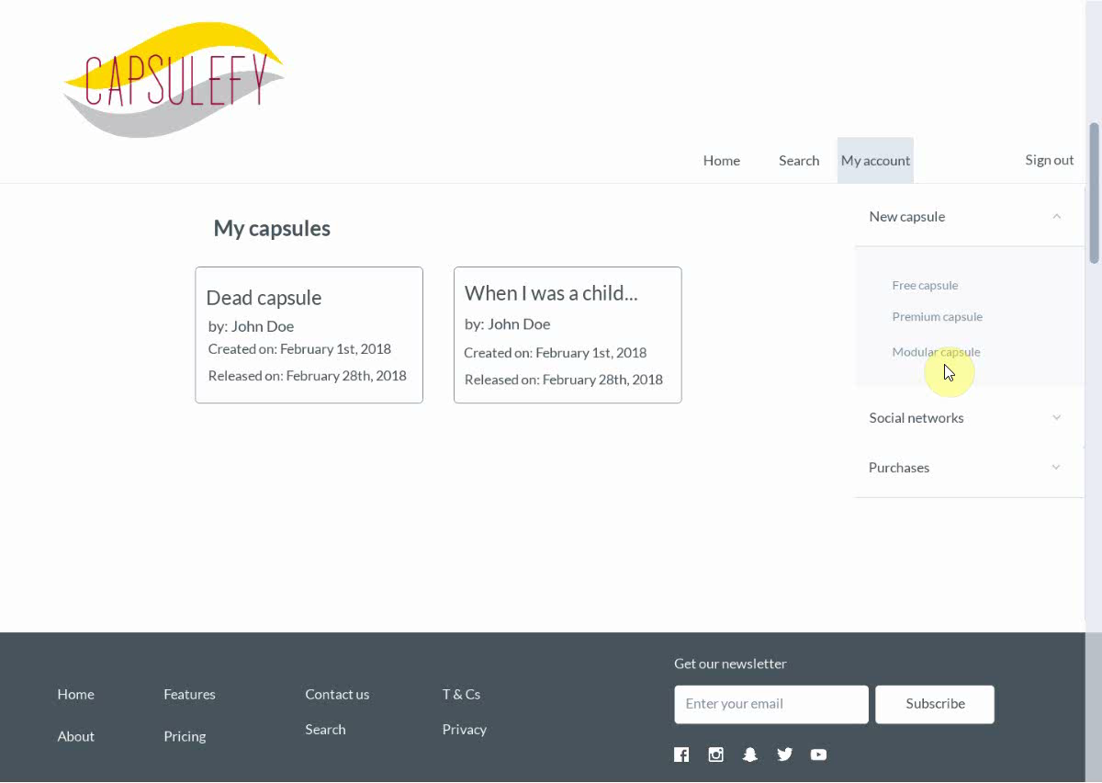
Logged-in user
Modular capsules

Slide 24
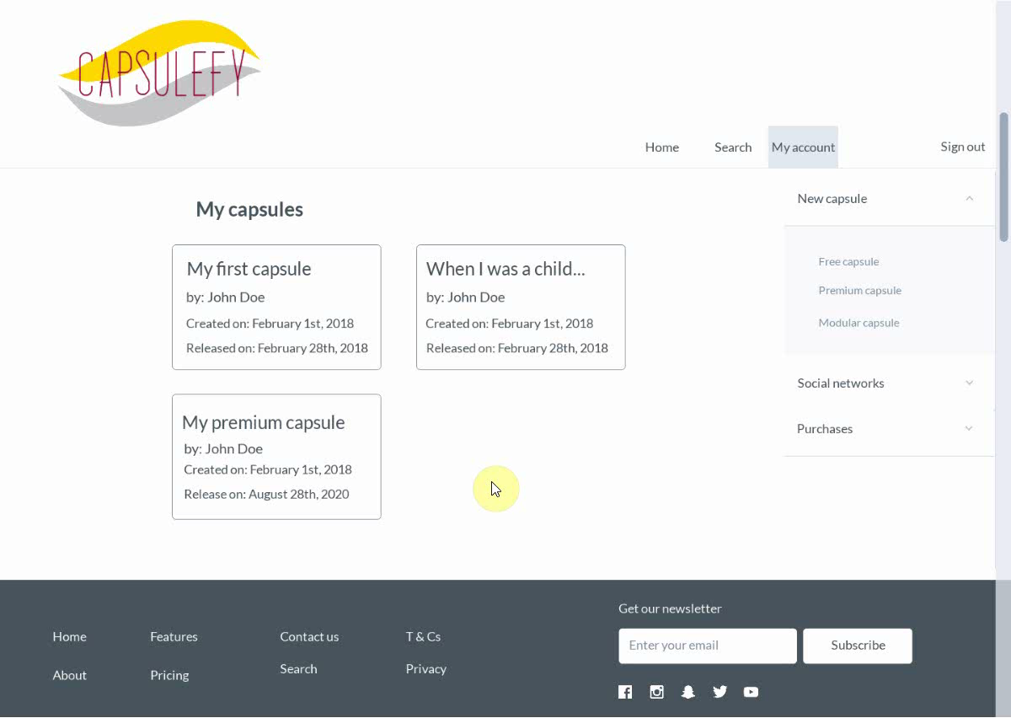
Logged-in user
Refresh capsules

Slide 25
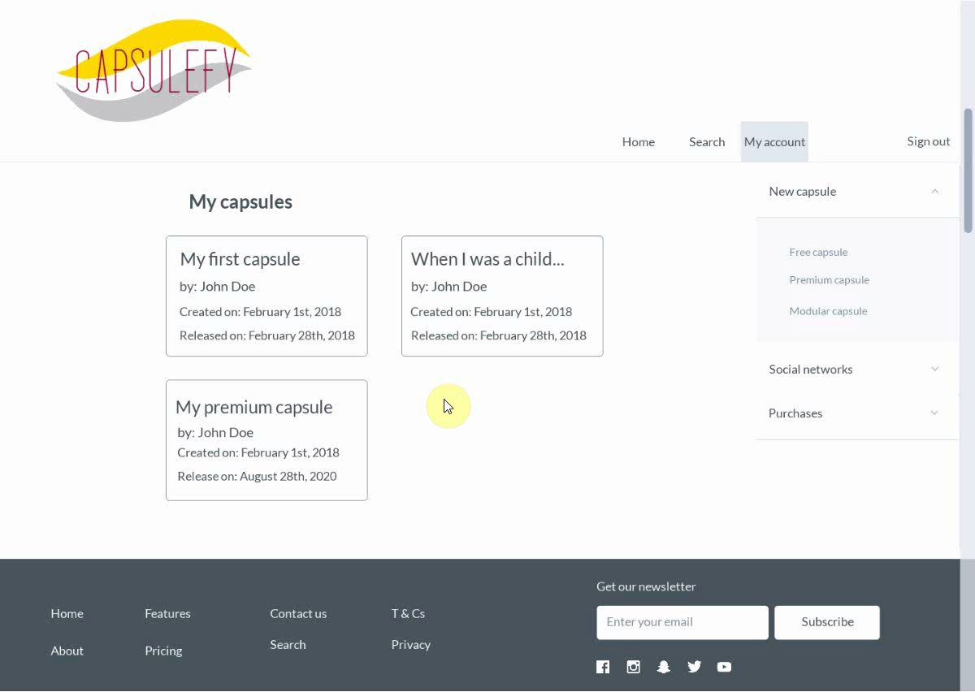
Logged-in user
Delete capsules

Slide 26
COMPETITORS

Slide 27


COMPETITORS
 | Viajeros en el tiempo | Mytimecapsule | Miigen | thetimecapsule | Capsulefy
Automatic content publication
Free version
Premium version
Images
Videos
Social network interaction
Dead man switch

Slide 28
PILOT USERS

Slide 29
PILOT USERS
Name | Age
Francisco R. | 55
Javier A. | 19
Valentin A. | 19
Antonio G. | 26
Name | Age
José Manuel J. | 21
Sandra C. | 28
José Manuel D. | 21

Slide 30
PAYMENT PLANS
 | Free | Premium/Modular
Price | 0 € | 11.99 €
Storage | 20 MB/user | 500 MB/capsule
Social network and email integration
Capsule scheduling | Up to 1 year | No limit
Capsule expiration | 6 months after release | No expiration
Private capsules (user-targeted)

Slide 31
VIDEO CONVERSION RATES
Quality (p) | MB/minute
144 | 1.3
240 | 3.3
360 | 5
480 | 8.3
720 | 25
1080 | 50

Slide 32
PLANIFICATION

Slide 33
PLANIFICATION
First sprint | Core use cases Piloting plan
Second sprint | Full MVP Feedback taken into account
Third sprint | Polished MVP

Slide 34
FIRST SPRINT: WEEK 1
Task | Assignees | Hours | Done
Data model | Adrián, Daniel, Juan, Pablo | 8.5
Advertisement budget | Pablo | 1.5
CUD basic capsule | Rafael | 2.5
Display capsule | Adrián | 2
List capsules | Juan | 1
User login | Juan | 1
Frontend | Daniel | 2
TIME
Notes:
Incomplete tasks are just missing tests.

Slide 35



PROBLEMS
Notes:
Bad scheduling, too little time for development, no equitative work balance.

Slide 36
FIRST SPRINT: WEEK 2
Task | Assignees | Hours
Modular and private capsules | Adrián, Juan | 4
Search capsules | Daniel | 2
Deadman switch | Pablo | 3
Email automation | Juan | 2
Social network integration | Rafael | 3
Frontend | Daniel | 2
Piloting plan | Adrián | 2
Notes:
All tasks will be worked on simultaneously.

Slide 37
COSTS

Slide 38


COSTS
Realistic: 29968.20 – 31330.39 €
Optimistic: 28061.13 €
Pesimistic: 34054.77 €
Project duration: 4 months
Notes:
Factors taken into account: salaries, workplace, hosting, adversitement.

Slide 39
COSTS (REALISTIC 1)
Project duration | 4 months
Salaries | 20.80 €/hour
Hours per month | 40
Amortization (months) | 60
Equipment | 306.67 €
Hosting (1 year) | 669.34 €
Advertising (6 months) | 3060 €
Risk prevention | 10% (2724.38 €)
Total | 29968.20 €

Slide 40
COSTS AFTER WEEK 1
Project duration | 6 weeks (1 development)
Salaries | 20.80 €/hour
Hours per month | 40
Total salaries | 4160 €
Amortization (months) | 60
Equipment | 115 €
Hosting | 0 €
Advertising | 0 €
Total | 4275 €

Slide 41





RISKS
Notes:
Computers not working, contracts changing, servers down, incompatible schedules, negative reception and losses.

Slide 42
PROFIT ESTIMATION

Slide 43
PROFIT ESTIMATION
Year 1: 2000 sales
Balance: -10168 €
Year 2: 4000 sales
Balance: 16273 €
29968 €
39600 €
19800 €
13159 €
Losses
Earnings
Losses
Earnings

Slide 44
PROFIT ESTIMATION
Year 3: 8000 sales
Balance: 81450 €
79200 €
14023 €
Losses
Earnings

Slide 45
THANKS!
Notes:
Insurance companies: offer capsules to their clients, with no expiration and special prices. Create endpoint for insurances to send their client data.

Slide 46

https://capsulefy.herokuapp.com
capsulefy.communications@gmail.com
https://marvelapp.com/4395g15/screen/53795517

Slide 47

CORE USE CASES
Refresh deadman switch
Select type of capsule
<<includes>>
Unregistered user
Registered user
Pay for a
capsule

Slide 48
CORE USE CASES
Delete
capsule
Create free
capsule
Unregistered user
View
capsule
Registered user

Slide 49
COSTS (REALISTIC 2)
Project duration | 4 months
Salaries | 20.80 €/hour
Hours per month | 40
Amortization (months) | 60
Equipment | 306.67 €
Hosting (1 year) | 669.34 €
Advertising (6 months) | 3060 €
Risk prevention | 15% (4086.57 €)
Total | 31330.39 €

Slide 50
COSTS (OPTIMISTIC)
Project duration | 4 months
Salaries | 20.80 €/hour
Hours per month | 40
Amortization (months) | 60
Equipment | 306.67 €
Hosting (1 year) | 669.34 €
Advertising (6 months) | 3060 €
Risk prevention | 3% (817.31 €)
Total | 28061.13 €

Slide 51
COSTS (PESIMISTIC)
Project duration | 4 months
Salaries | 20.80 €/hour
Hours per month | 40
Amortization (months) | 60
Equipment | 306.67 €
Hosting (1 year) | 669.34 €
Advertising (6 months) | 3060 €
Risk prevention | 25% (6810.95 €)
Total | 34054.77 €

Slide 52

PLANIFICATION
Each week
Sprint planning
Send deliverable
Each deliverable

Slide 53
FIRST SPRINT
- Prepare development environment
- Implement data models
- Work on requirements
- Test the system
- Take actions according to feedback

Slide 54



TESTING
Functional
%
Integration
Performance
Coverage
Acceptance

Slide 55


COMMITMENT

Slide 56

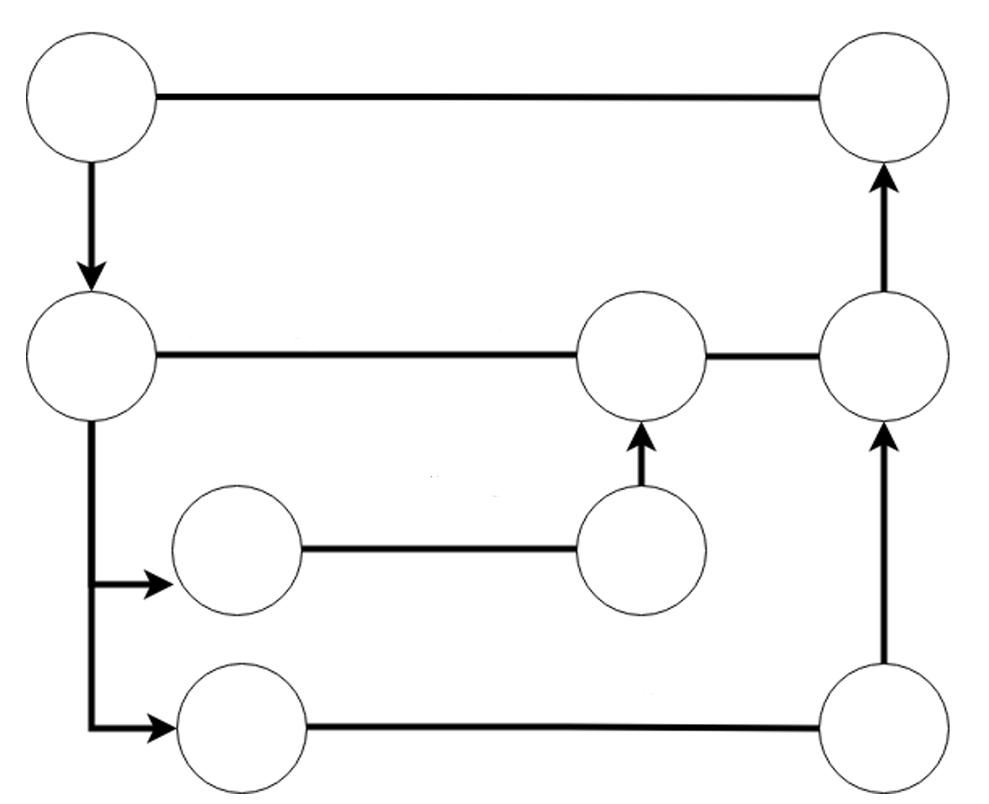
ALM
Master
Release X
Development
Features

Slide 57


HOSTING

Slide 58
VIABILITY STUDY

Slide 59
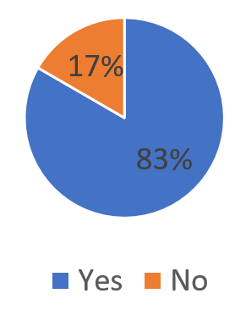
Do you know what a time capsule is?

Slide 60
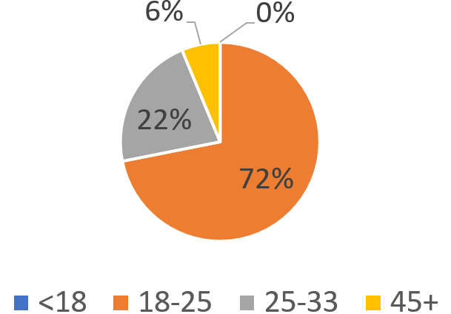
What is your age?

Slide 61
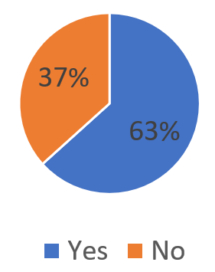
Are you interested in our idea?

Slide 62
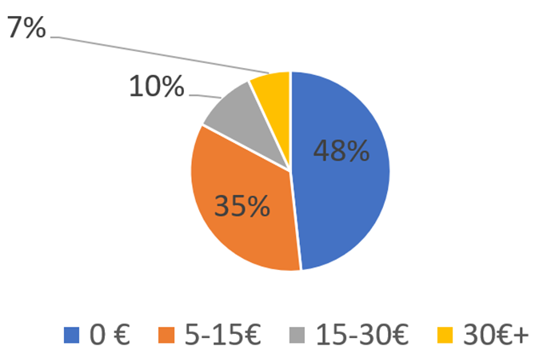
How much would you pay yearly?

Slide 63
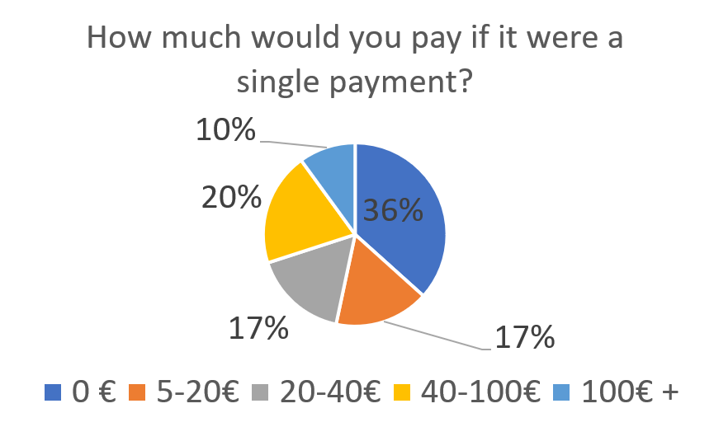
How much would you pay if it were a single payment?

Slide 64



SWOT MATRIX
STRENGTHS | WEAKNESSES
OPPORTUNITIES | THREATS
Deadman switch
and customization
New to the
market
Insurance companies
Competitors and lack of trust

Slide 65

CLASSIFICATION
=

